Slide 1

Fake scams
Don't trust everything you see online!!!

Slide 2
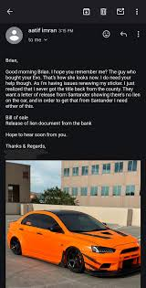

IS IT TOO GOOD TO BE TRUE?
This is a message that shows a type of scam message that people might fall for think about it is too good to be true?

Slide 3

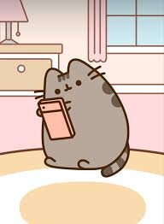

FAKE WEBSITES
Don't always believe that the websites are real but sometimes you can you can tell if it's fake or not because of the name real ones normally end in .com or .co.uk if it is spelled wrong then you would probably be able
To tell as well

Slide 4

CALLS/TEXTS/EMAILS FROM RANDOM NUMBERS
Have you ever received a random text from a number you don't know?
IF you have make sure to
.REPORT
.BLOCK
AND DELETE NUMBER

