Slide 1

Online Safety
Scams and what they look like + tips

Slide 2
HOW TO STAY SAFE ON YOUR DEVICE
If you get any calls/texts from random numbers that are not in your contacts,make sure to delete them
make sure to remember that if things are too good to be true, they most likely to be a scam
If you get emails/ voicemails from people you don't know, always tell a trusted adult or block them

Slide 3
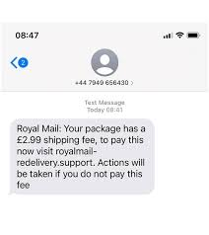
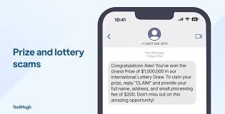
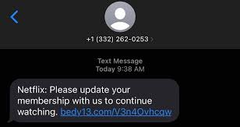
SCAM EXAMPLES THAT ARE COMMON

Slide 4
TALKING TO TRUSTED ADULTS
IT IS VERY IMPORTANT TO HAVE SOMEONE TO TALK TO
IT CAN BE A CARER OR SOMEONE IN YOUR FAMILY OR EVEN A FRIEND
JUST MAKE SURE TO ALWAYS DOUBLE CHECK BEFORE PRESSING DOWN ON A BUTTON OR LINK
IF YOU FEEL UNCOMFORTABLE, NEVER PRESS THE LIN AS IT COULD TAKE AWAY PERSONAL INFORMATION!
STAY SAFE

Slide 5
PERSONAL INFORMATION
NEVER share personal info such as date of birth, address,debit card number ,phone numbers and email addresses
Don't give anything away when pressing links from online shoppping you've never heard about
Don't give your name or age away when playing online games!

Slide 6
SMART
Safe. Don't talk to anyone you do not know
Meet. NEVER agree to meet someone you don't know or ever give your house address
Accepting. Accept that not everything that you read and do not accept offers
Reliable. Do not rely on everything you see on the internet
Tell a trusted adult
SMART

Slide 7


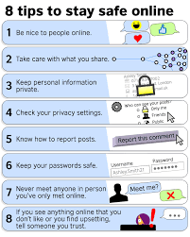
BE safe!!!

Slide 8
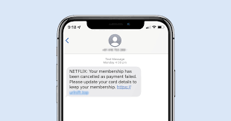
EXAMPLE OF A SCAM
YOU NEED TO UPDATE YOUR NETFLIX PAYMENT!
CLICK THE KINK BELOW TO PAY YOUR FEE
https://@netflix.payyourfee.com
NEVER PRESS UNKNOWN LINK!

