Slide 1

Scams
How to notice a scam.

Slide 2
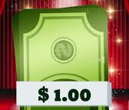

How to know that you are being scammed! First, you need to read what it saYS.
it could be 'you won £100clik to claim - this is not a scam'
Money.com.uk

